Slide 1
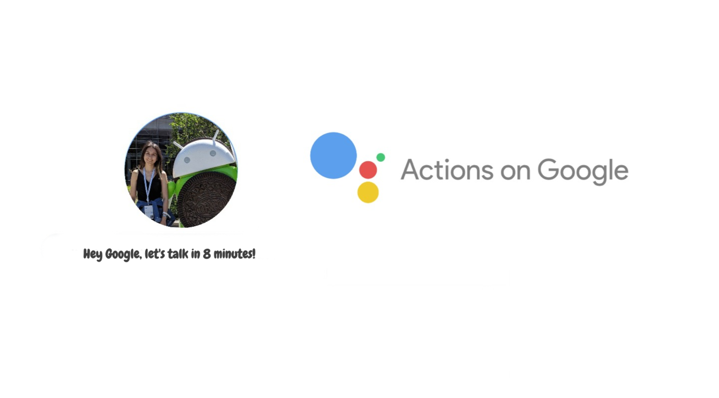
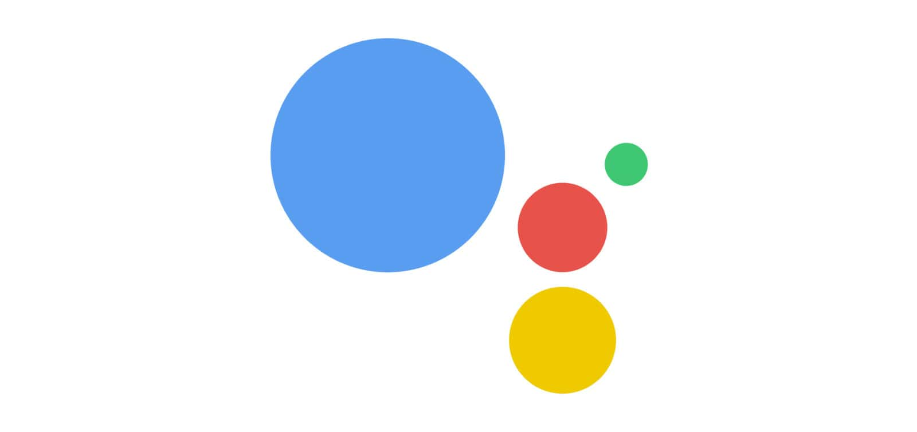
Google Assistant in 8 Minutes

Slide 2




MERVE BAŞAK
Computer Engineering @Anadolu University
GDG Eskisehir Organizer
WTM Eskisehir Ambassadors
@mervebasak
/bsk_mrv
/mervebasak

Slide 3

What is Action on Google?
What is Google Assistant?
Actions on Google is a developer platform that let’s us create software to extend the functionality of the Google Assistant. As a developer, we can use Actions on Google to easily create and manage delightful and effective conversational experiences between users and our own 3rd-party fulfillment service.
Google Assistant is a smart personal assistant first announced in May 2016 in Google I / O. Google Assistant extends to help you across devices, like Google Home, your phone, and more.
Notes:
Google asistan nedir? Action on google nedir ?

Slide 4
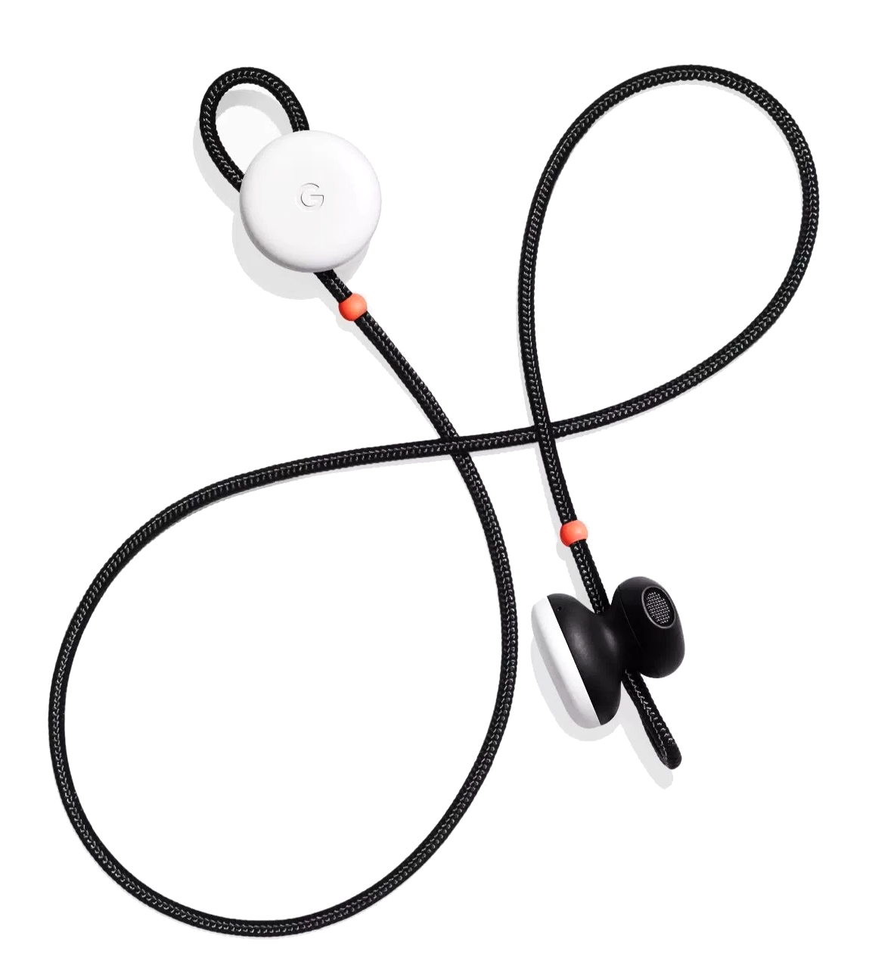

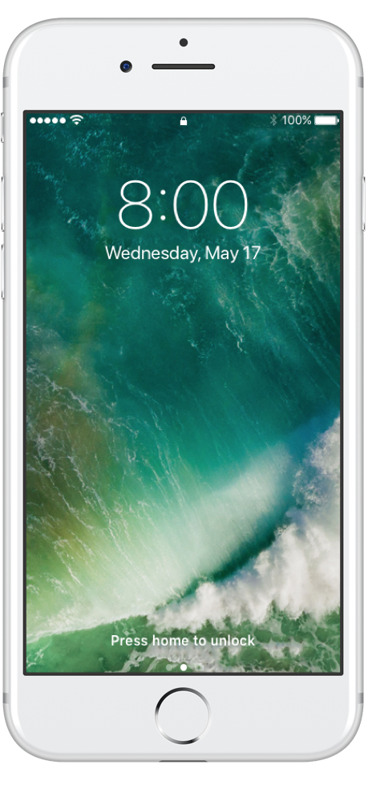
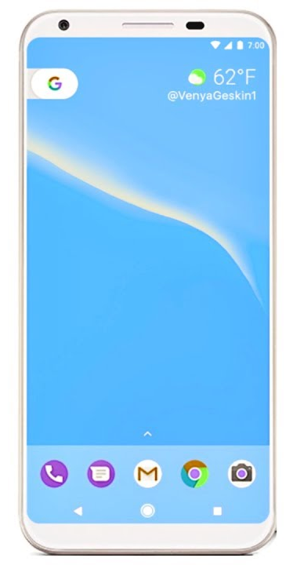
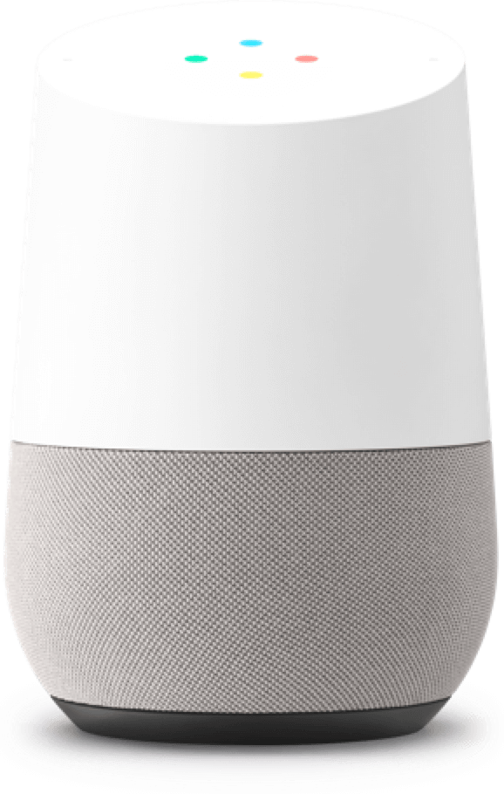
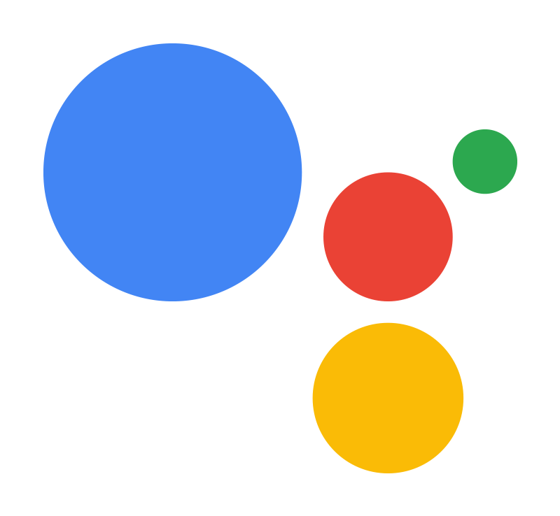
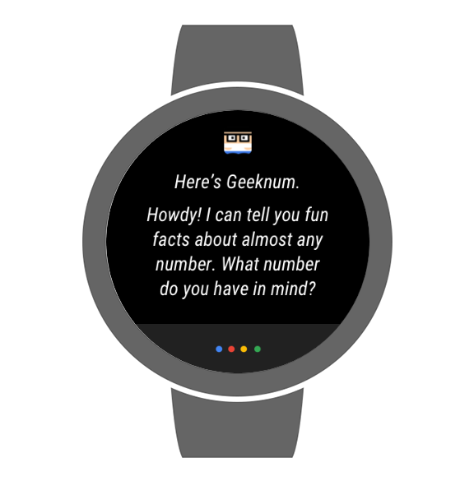
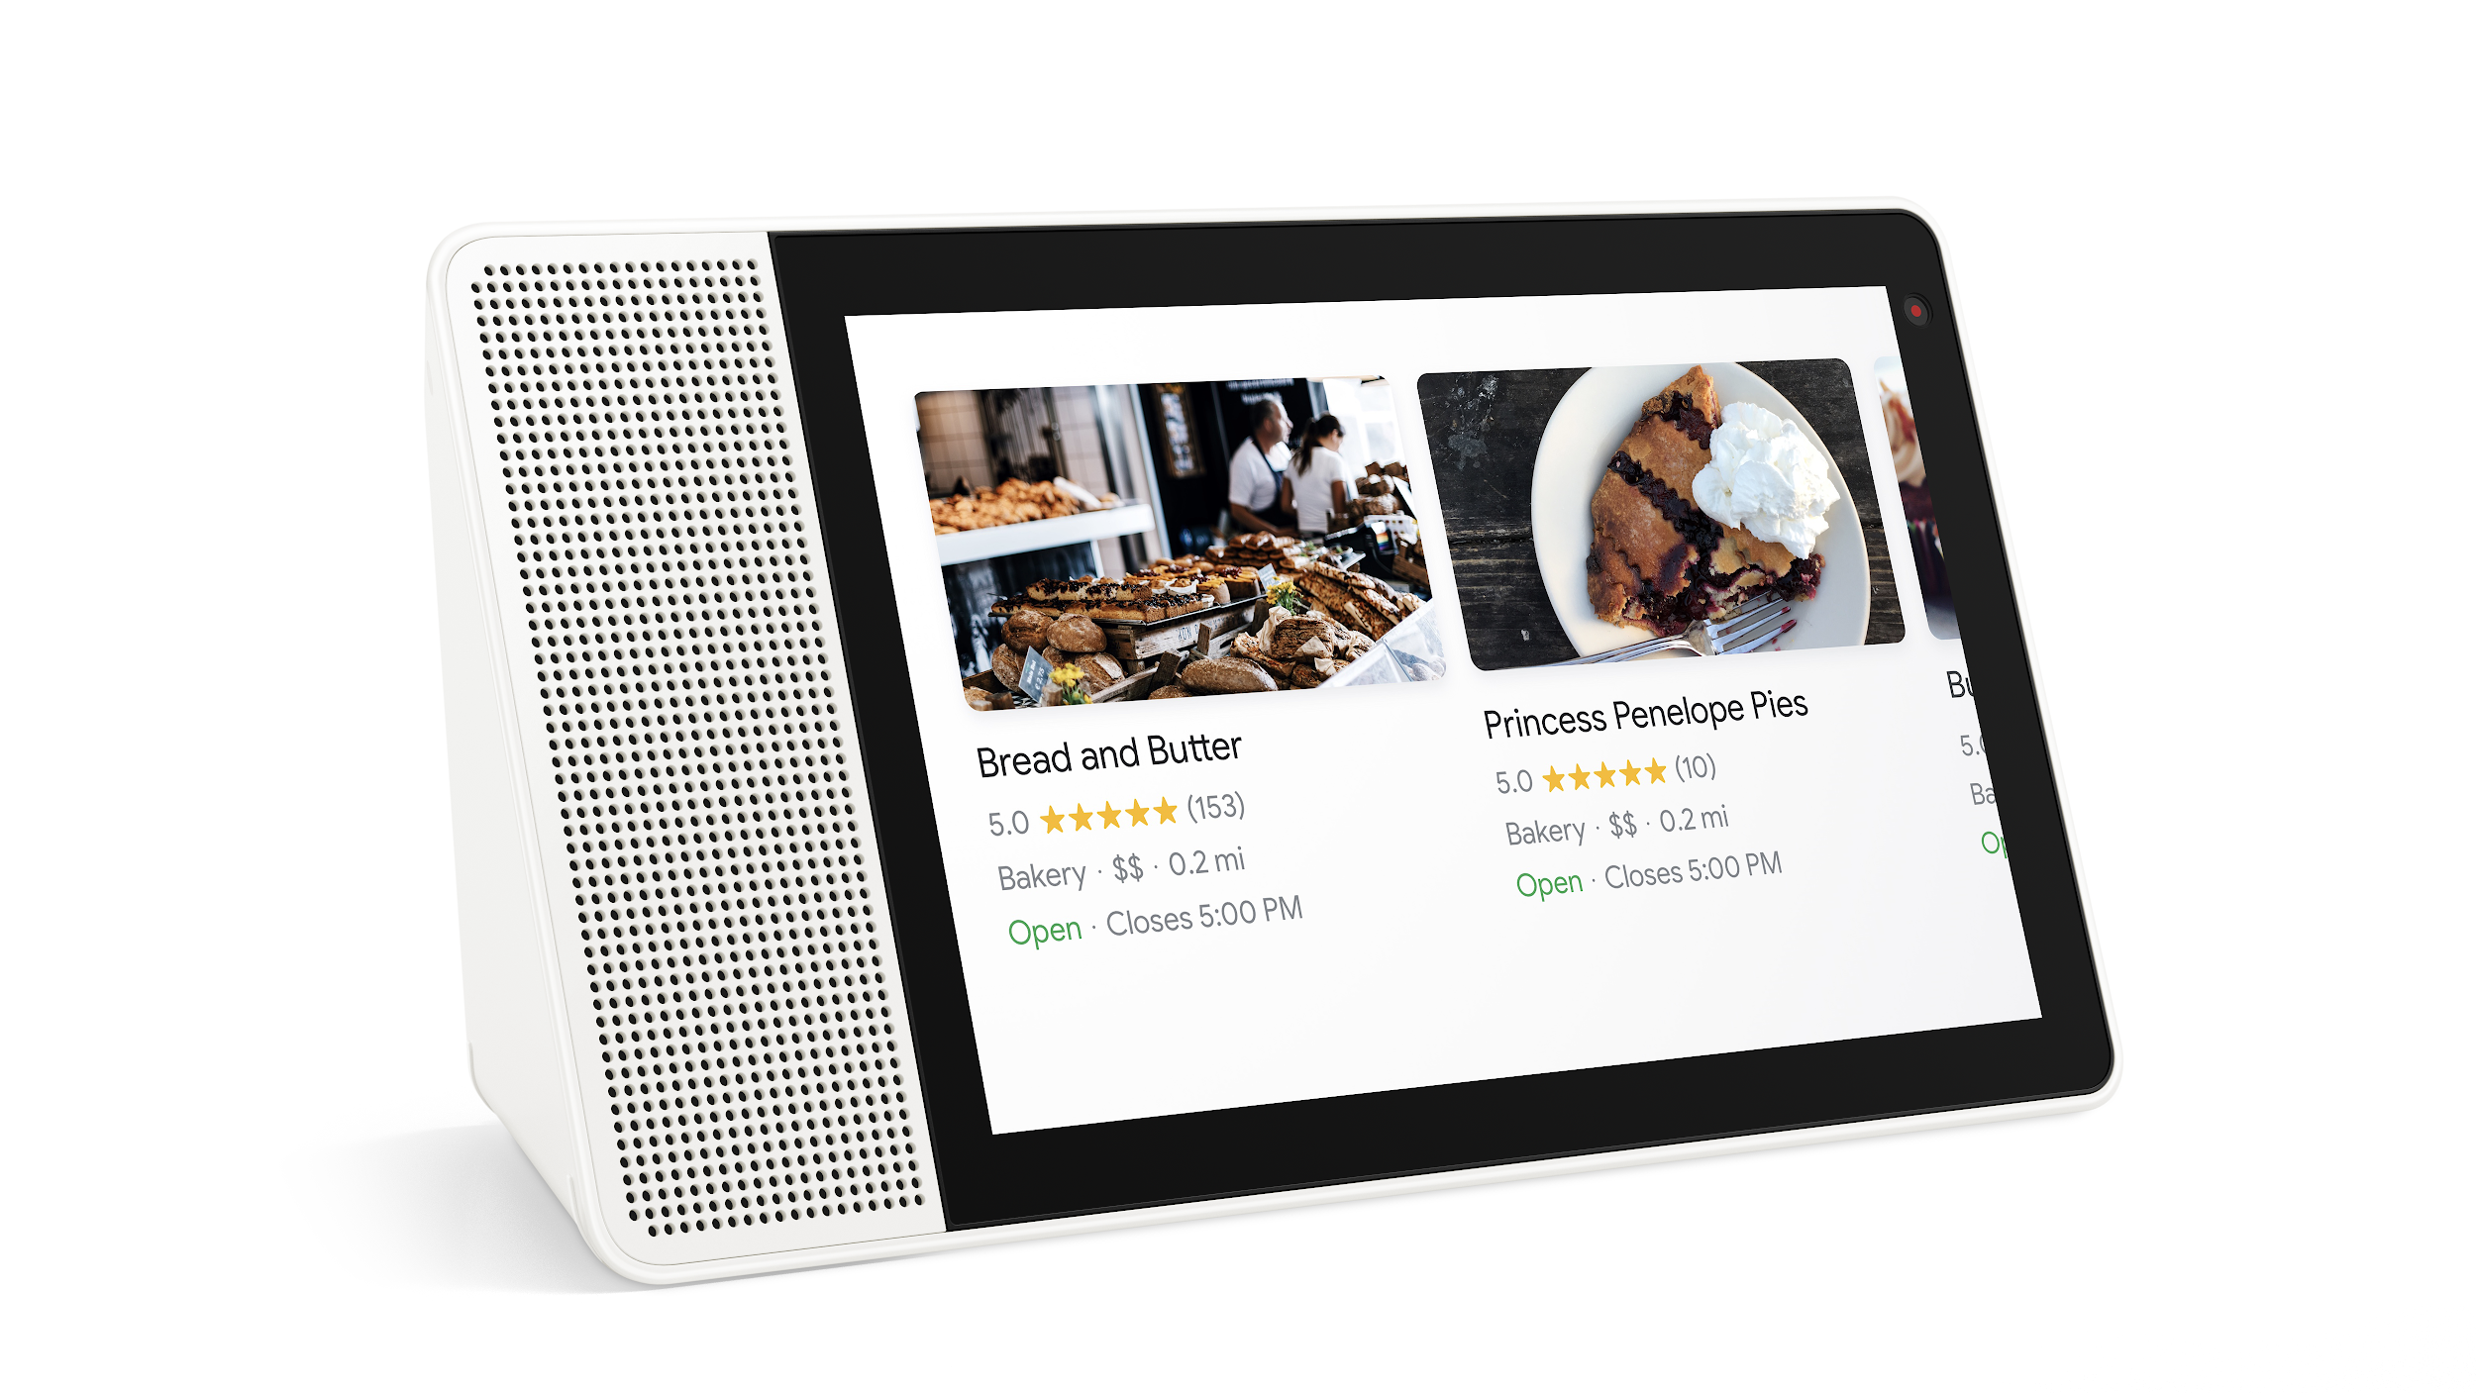
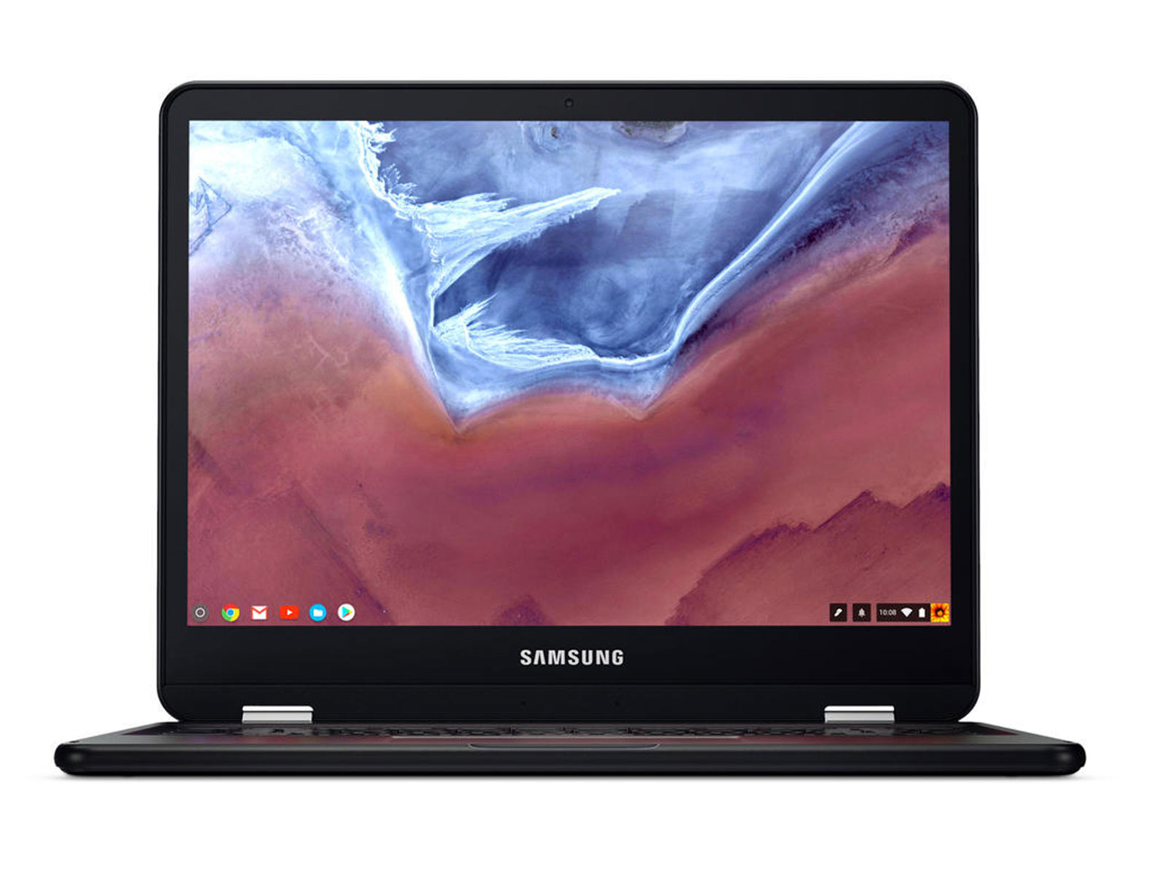
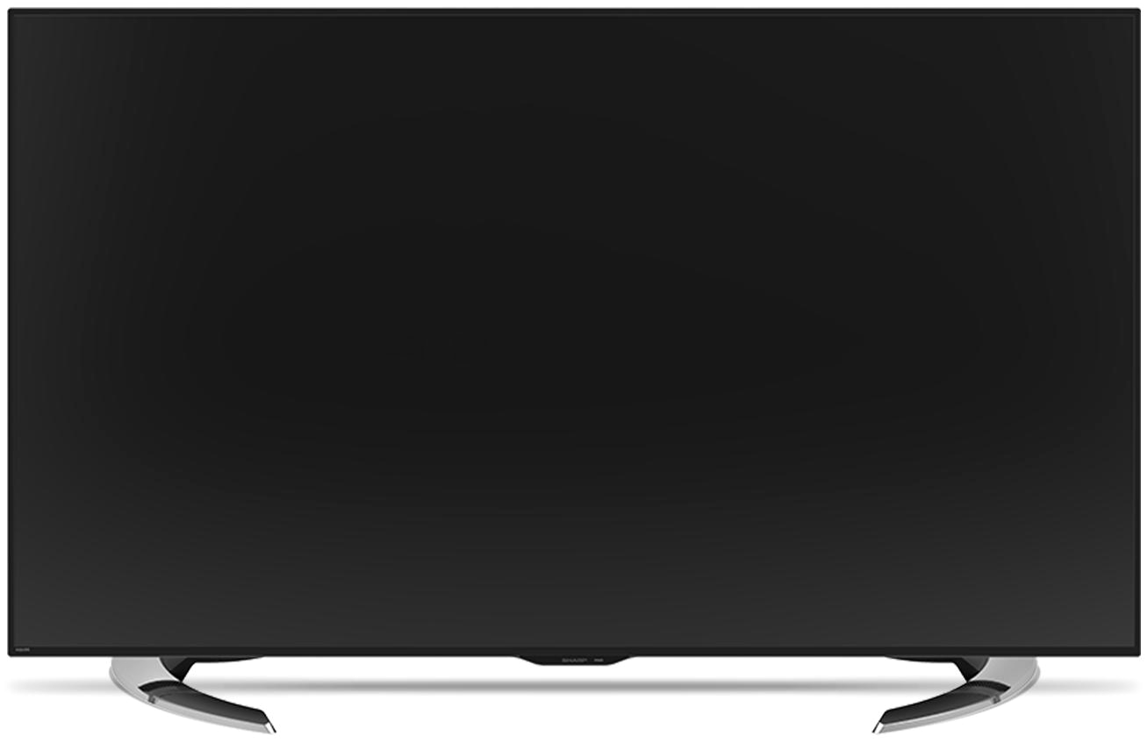
Google Assistant, across more than 500 million devices,
including smart speakers, phones, cars, TVs,
headphones, watches, and more.
Notes:
Nerelerde var

Slide 5
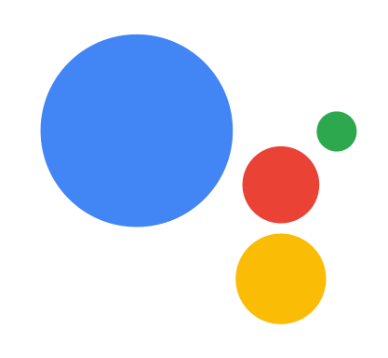
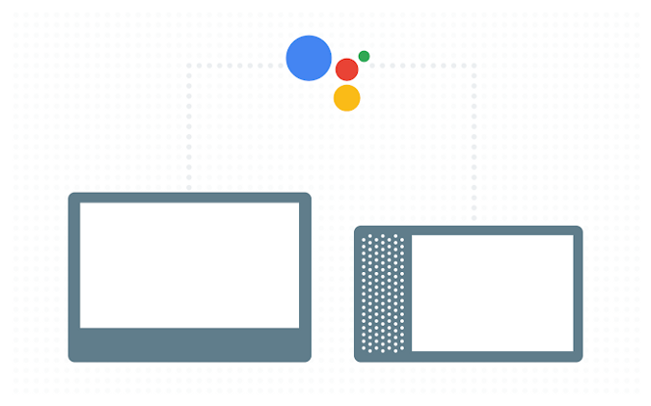
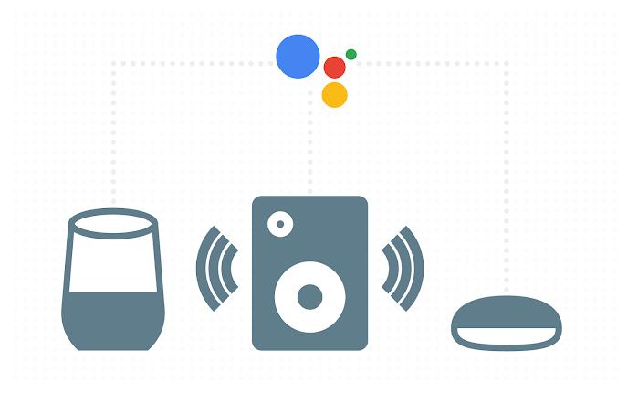
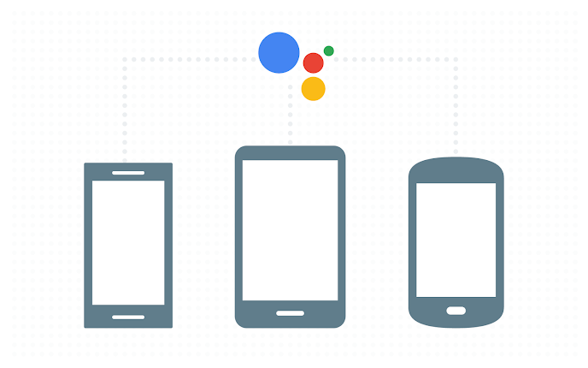
Smart Displays: Devices with screens make it easy for users to quickly scan lists or make selections, in common use cases like shopping or product browsing.
Smart Speakers: These devices use only voice and audio for their user experience that make hands-free interactions and multi-tasking easy for users.
Smart Phones: Phones are multimodal, combining voice and visual interactions like Smart Displays, but with the added benefit of mobility.

Slide 6











What Google Assistant can do ?
Notes:
neler yapıyor

Slide 7

Resources to start and support
Console
bit.ly/buildactions-console
Build with Templates
developers.google.com/actions/templates
Build with Dialogflow
developers.google.com/actions/dialogflow
Build with Actions SDK
developers.google.com/actions/sdk
Documentation
developers.google.com/actions
Codelabs
codelabs.developers.google.com
Cloud Functions
bit.ly/firebase-get-started
Deploy your webhook fulfillment using Cloud Functions from Firebase
bit.ly/aog-cloud-functions
Notes:
Nasıl action geliştirebilirim

Slide 8
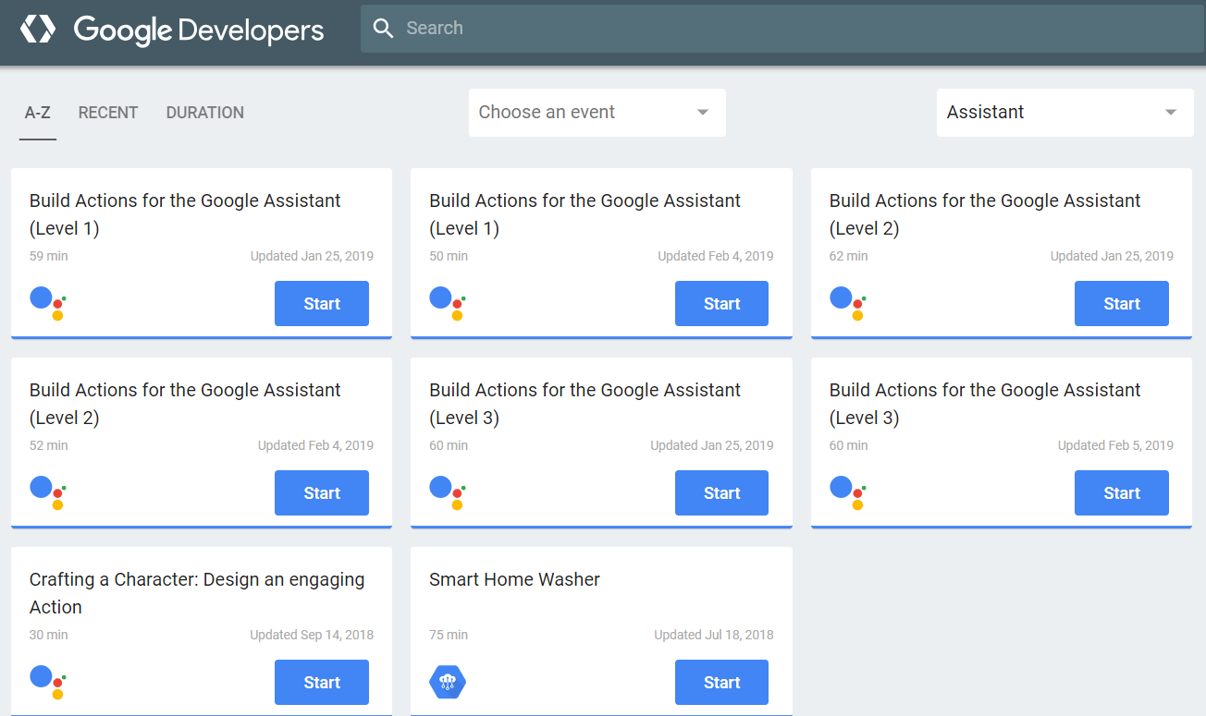
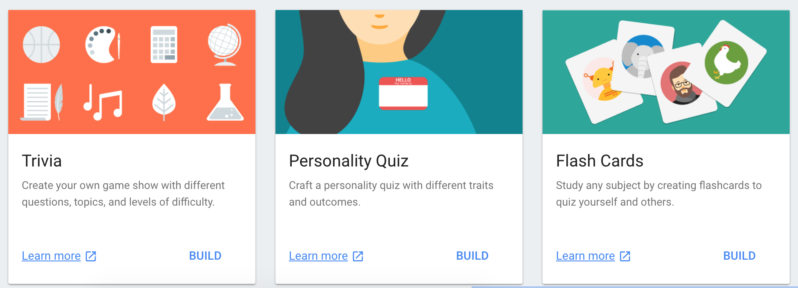
Templates
developers.google.com/actions/templates
Codelabs
codelabs.developers.google.com

Slide 9
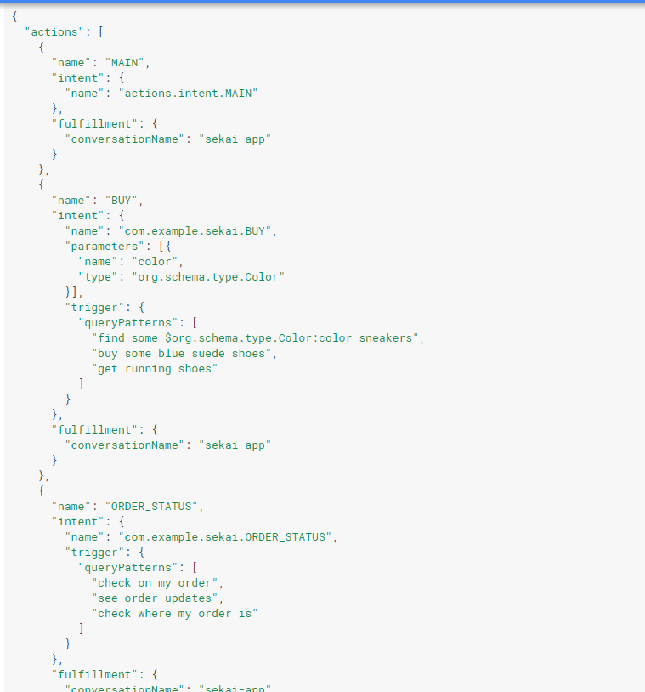
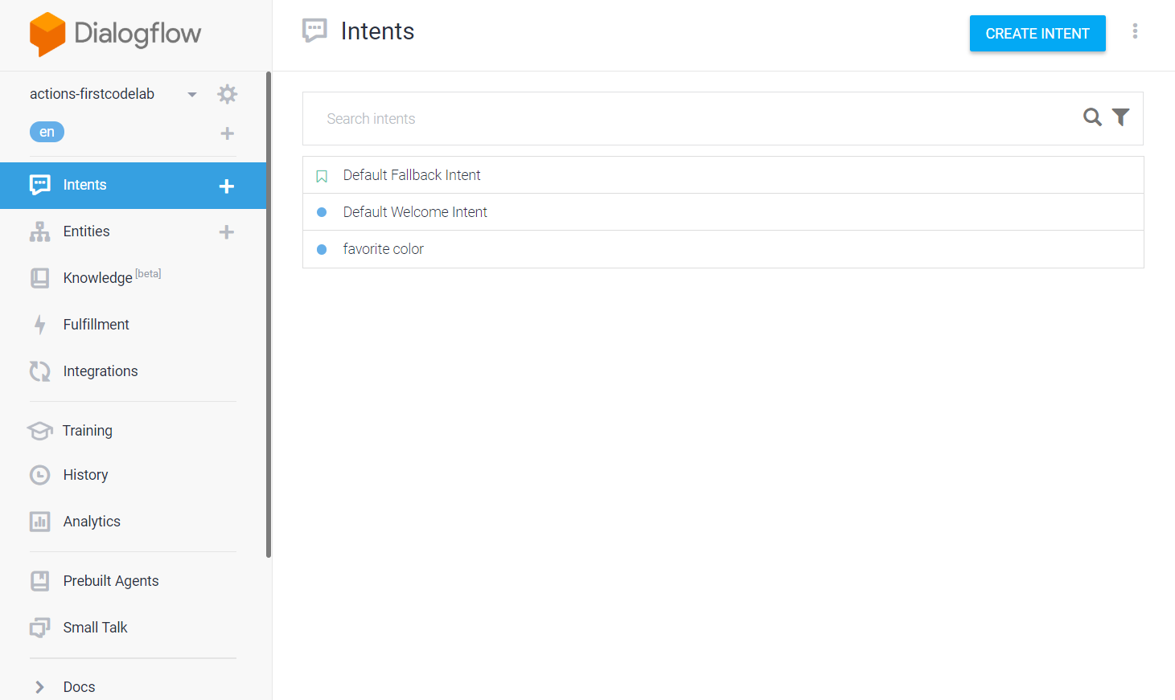
Dialogflow
developers.google.com/actions/dialogflow
Action SDK
developers.google.com/actions/sdk

Slide 10

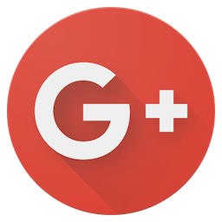
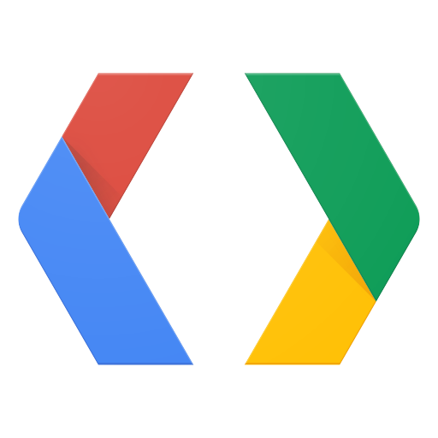
Actions on Google Twitter
https://twitter.com/actionsongoogle
#AoGDevs
Actions on Google Developers
https://developers.google.com/actions
Actions on Google Developer Community
https://g.co/actionsdev
Notes:
Topluluk hakkında

Slide 11


